Slide 1
Deep Learning Methods for Solving Partial Differential Equations
Team Members:
Hashim Alsadah.
Abdulwahab Alghamdi.
Hussain Alsinan.
Adviser:
Dr. Jamal Al-Smail.

Slide 2
Introduction
Partial differential equations (PDEs) are essential components for modelling different processes and systems in various scientific and engineering area such as modeling fluid flow (Navier–Stokes eqs), EMR in wireless communication(Maxwell’s eqs), and MD (Newton’s eqs).
Traditional methods for approximating the solution of PDEs include Finite Difference (FD), Finite Element (FE), Finite Volume (FV), Method of Lines (MOL), etc,….
Mesh-based methods can be computationally expensive, especially for high dimensional problems and problems with large and irregular domain.

Slide 3
Why Neural Networks?
NNs are capable of approximating any measurable function with from one finite set to another with any desired degree of accuracy given sufficient number of hidden units (Hornik et el, 1989).[1]
NNs can be used as mesh-free method to approximate the solution of PDEs.
There are different models that use DNNs to approximate PDEs, including PINNs, FRNN, GNN, FNO, DeepOnet, etc,…

Slide 4

Physics Informed Neural Networks
Physics-informed Neural Network (PINN) (Raissi et al., 2019). is the most basic and widely used model for approximating PDEs' solutions.[2]
PINN is unsupervised learning model used to approximate the solution of a PDE. PINN incorporate the physical prior knowledge of the problem in the neural network’s (NN) loss function.
$$ℱ\left(u,θ\right)\left(x, t\right)=f\left(x,t\right) \left[x,t\right]∈Ω$$
$$ℬ\left(u, θ\right)\left(x, t\right)=g\left(t\right) x∈∂Ω$$
$$ℐ\left(u, θ\right)\left(x, t\right)=h\left(x\right) t∈∂Ω_{0}$$

Slide 5
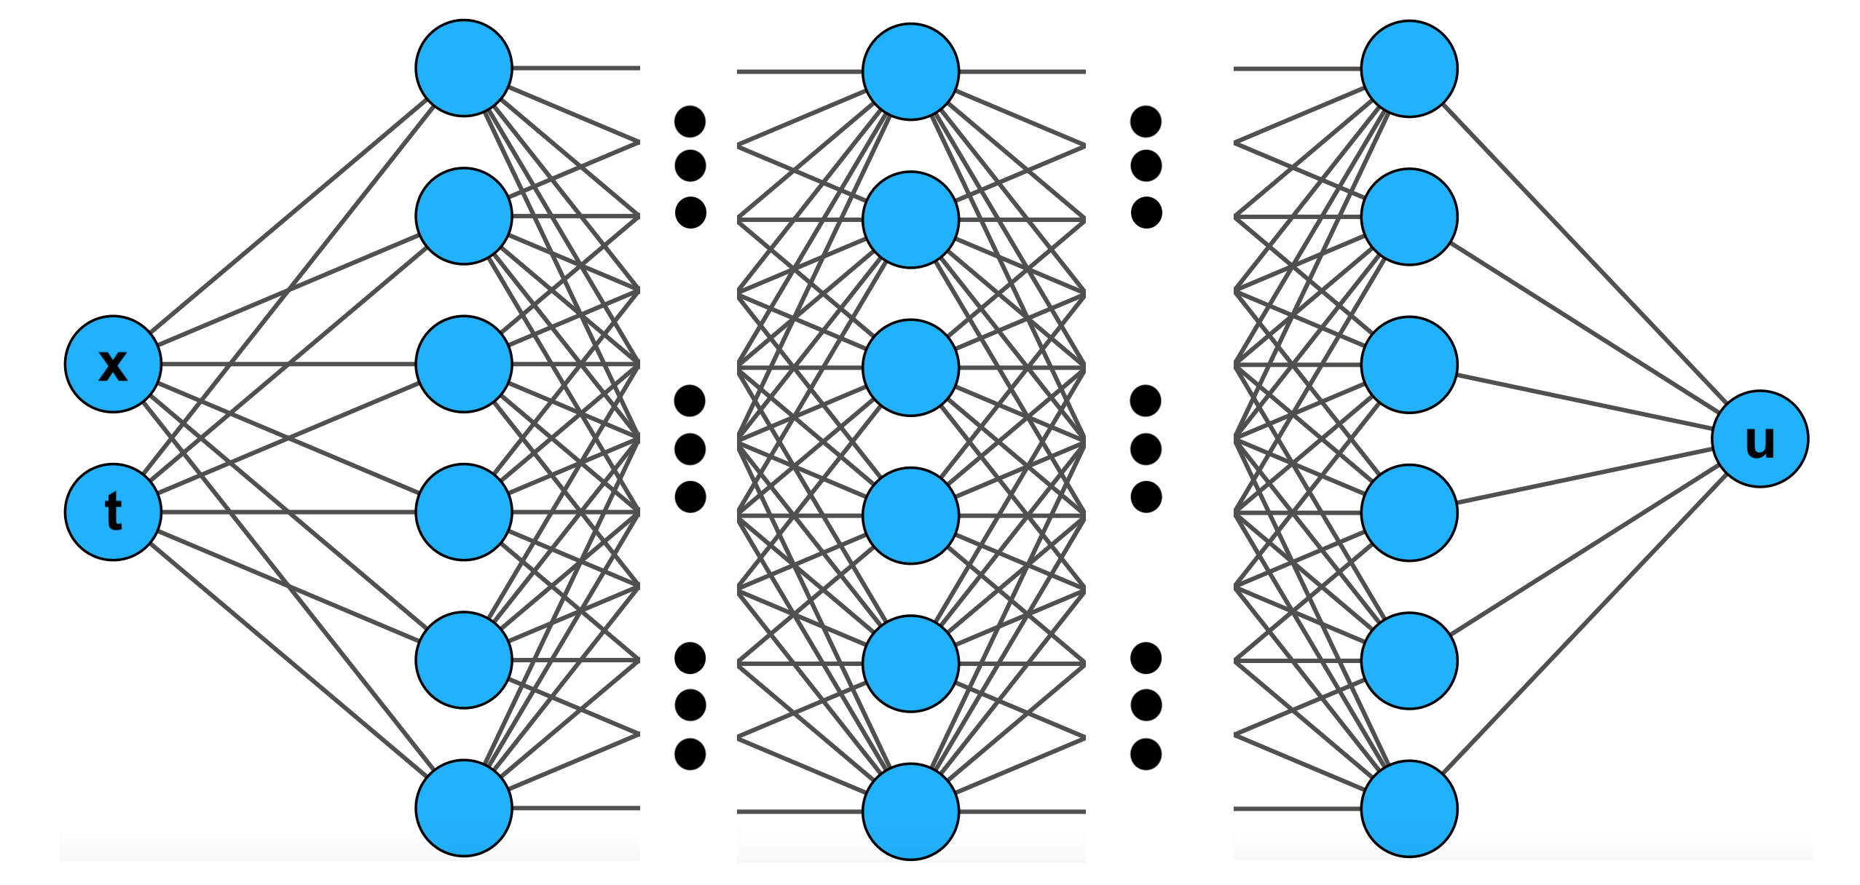
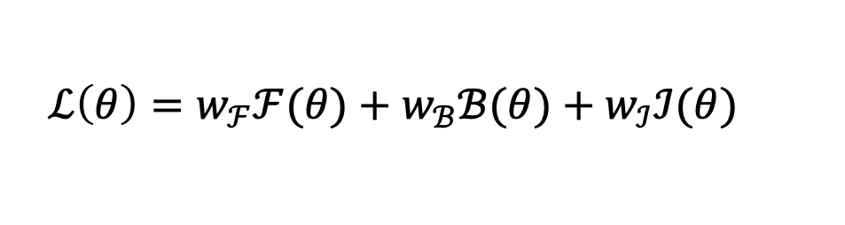
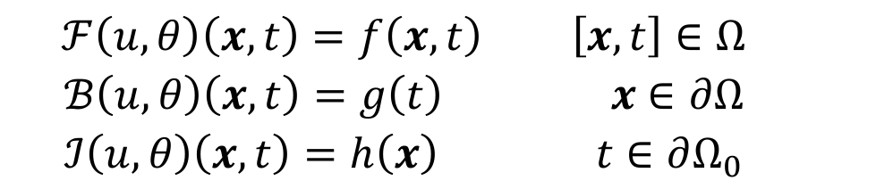
Physics Informed Neural Networks
$$ℱ\left(u,θ\right)\left(x, t\right)=f\left(x,t\right) \left[x,t\right]∈Ω$$
$$ℬ\left(u, θ\right)\left(x, t\right)=g\left(t\right) x∈∂Ω$$
$$ℐ\left(u, θ\right)\left(x, t\right)=h\left(x\right) t∈∂Ω_{0}$$
$$ℒ\left(θ\right)=w_{ℱ}ℱ(θ)+w_{ℬ}ℬ(θ)+w_{ℐ}ℐ(θ)$$
Note: PINNs use the algorithm of Automatic Differentiation (AD) to compute the derivative of the output with respect to the inputs.[3]

Slide 6
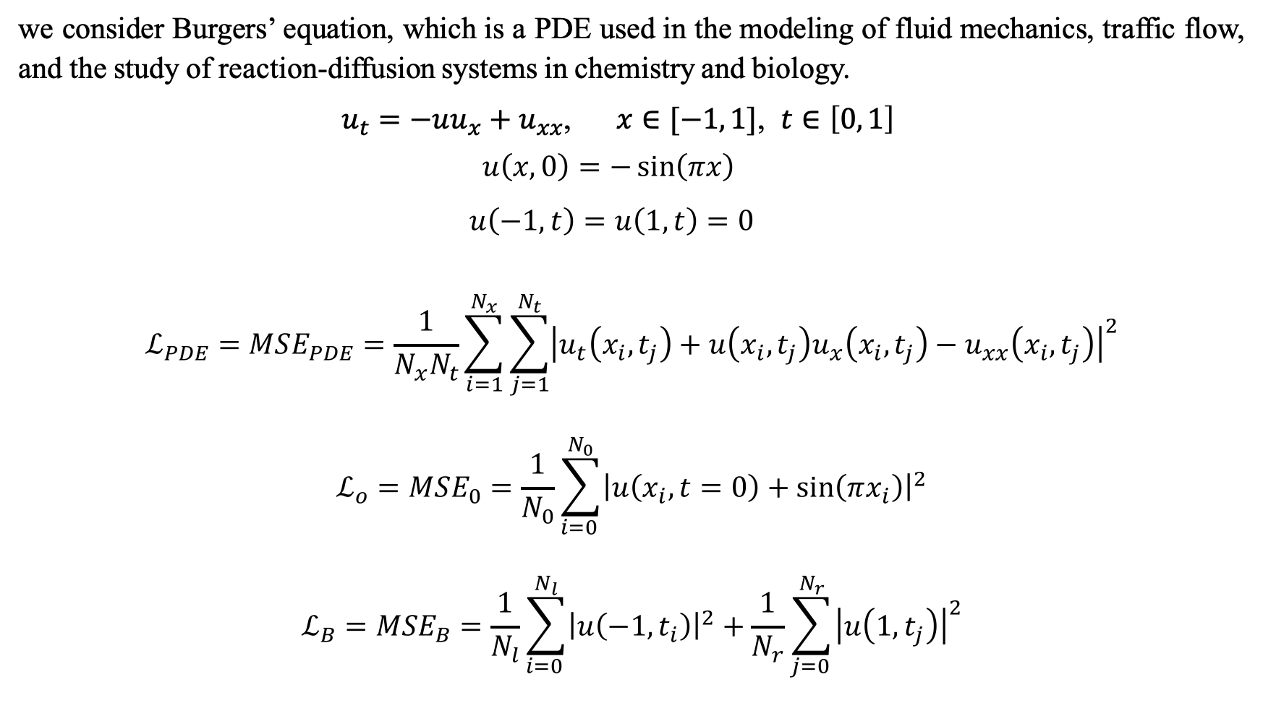
Example
we consider Burgers’ equation, which is a PDE used in the modeling of fluid mechanics, traffic flow, and the study of reaction-diffusion systems in chemistry and biology.
$u_{t}=−uu_{x}+u_{xx}$, $x∈[−1, 1]$, $t∈\left[0, 1\right]$
$$u\left(x,0\right)=−\sin\left(πx\right)$$
$$u\left(−1, t\right)=u\left(1, t\right)=0$$
$$ℒ_{PDE}=MSE_{PDE}=\frac{1}{N_{x}N_{t}}\sum_{i=1}^{N_{x}}{\sum_{j=1}^{N_{t}}{{\left|u_{t}\left(x_{i}, t_{j}\right)+u\left(x_{i}, t_{j}\right)u_{x}\left(x_{i},t_{j}\right)−u_{xx}\left(x_{i},t_{j}\right)\right|}^{2}}}$$
$$ℒ_{o}=MSE_{0}=\frac{1}{N_{0}}\sum_{i=0 }^{N_{0}}{{\left|u\left(x_{i}, t=0\right)+\sin\left(πx_{i}\right)\right|}^{2}}$$
$$ℒ_{B}=MSE_{B}=\frac{1}{N_{l}}\sum_{i=0 }^{N_{l}}{{\left|u\left(−1,t_{i}\right)\right|}^{2}}+\frac{1}{N_{r}}\sum_{j=0 }^{N_{r}}{{\left|u\left(1,t_{j}\right)\right|}^{2}}$$

Slide 7
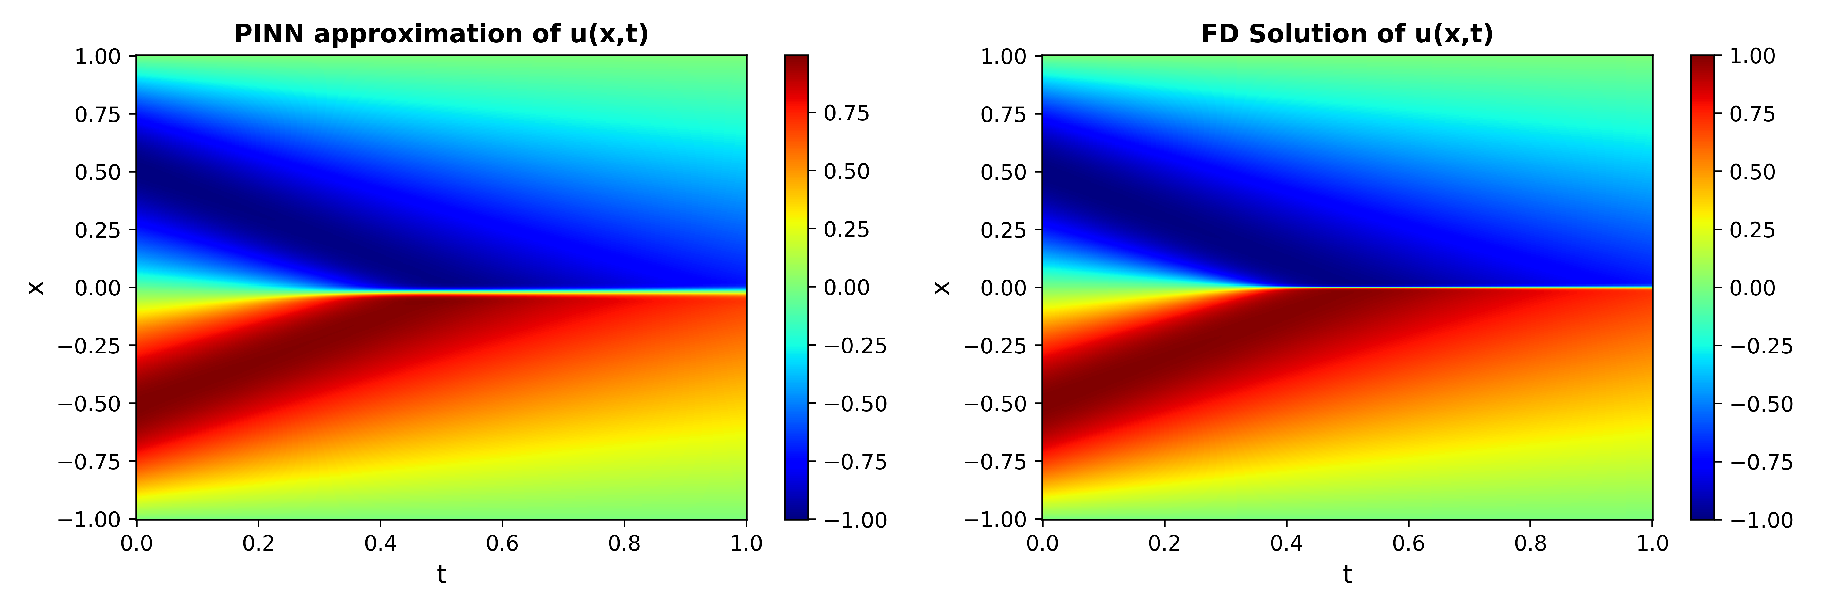
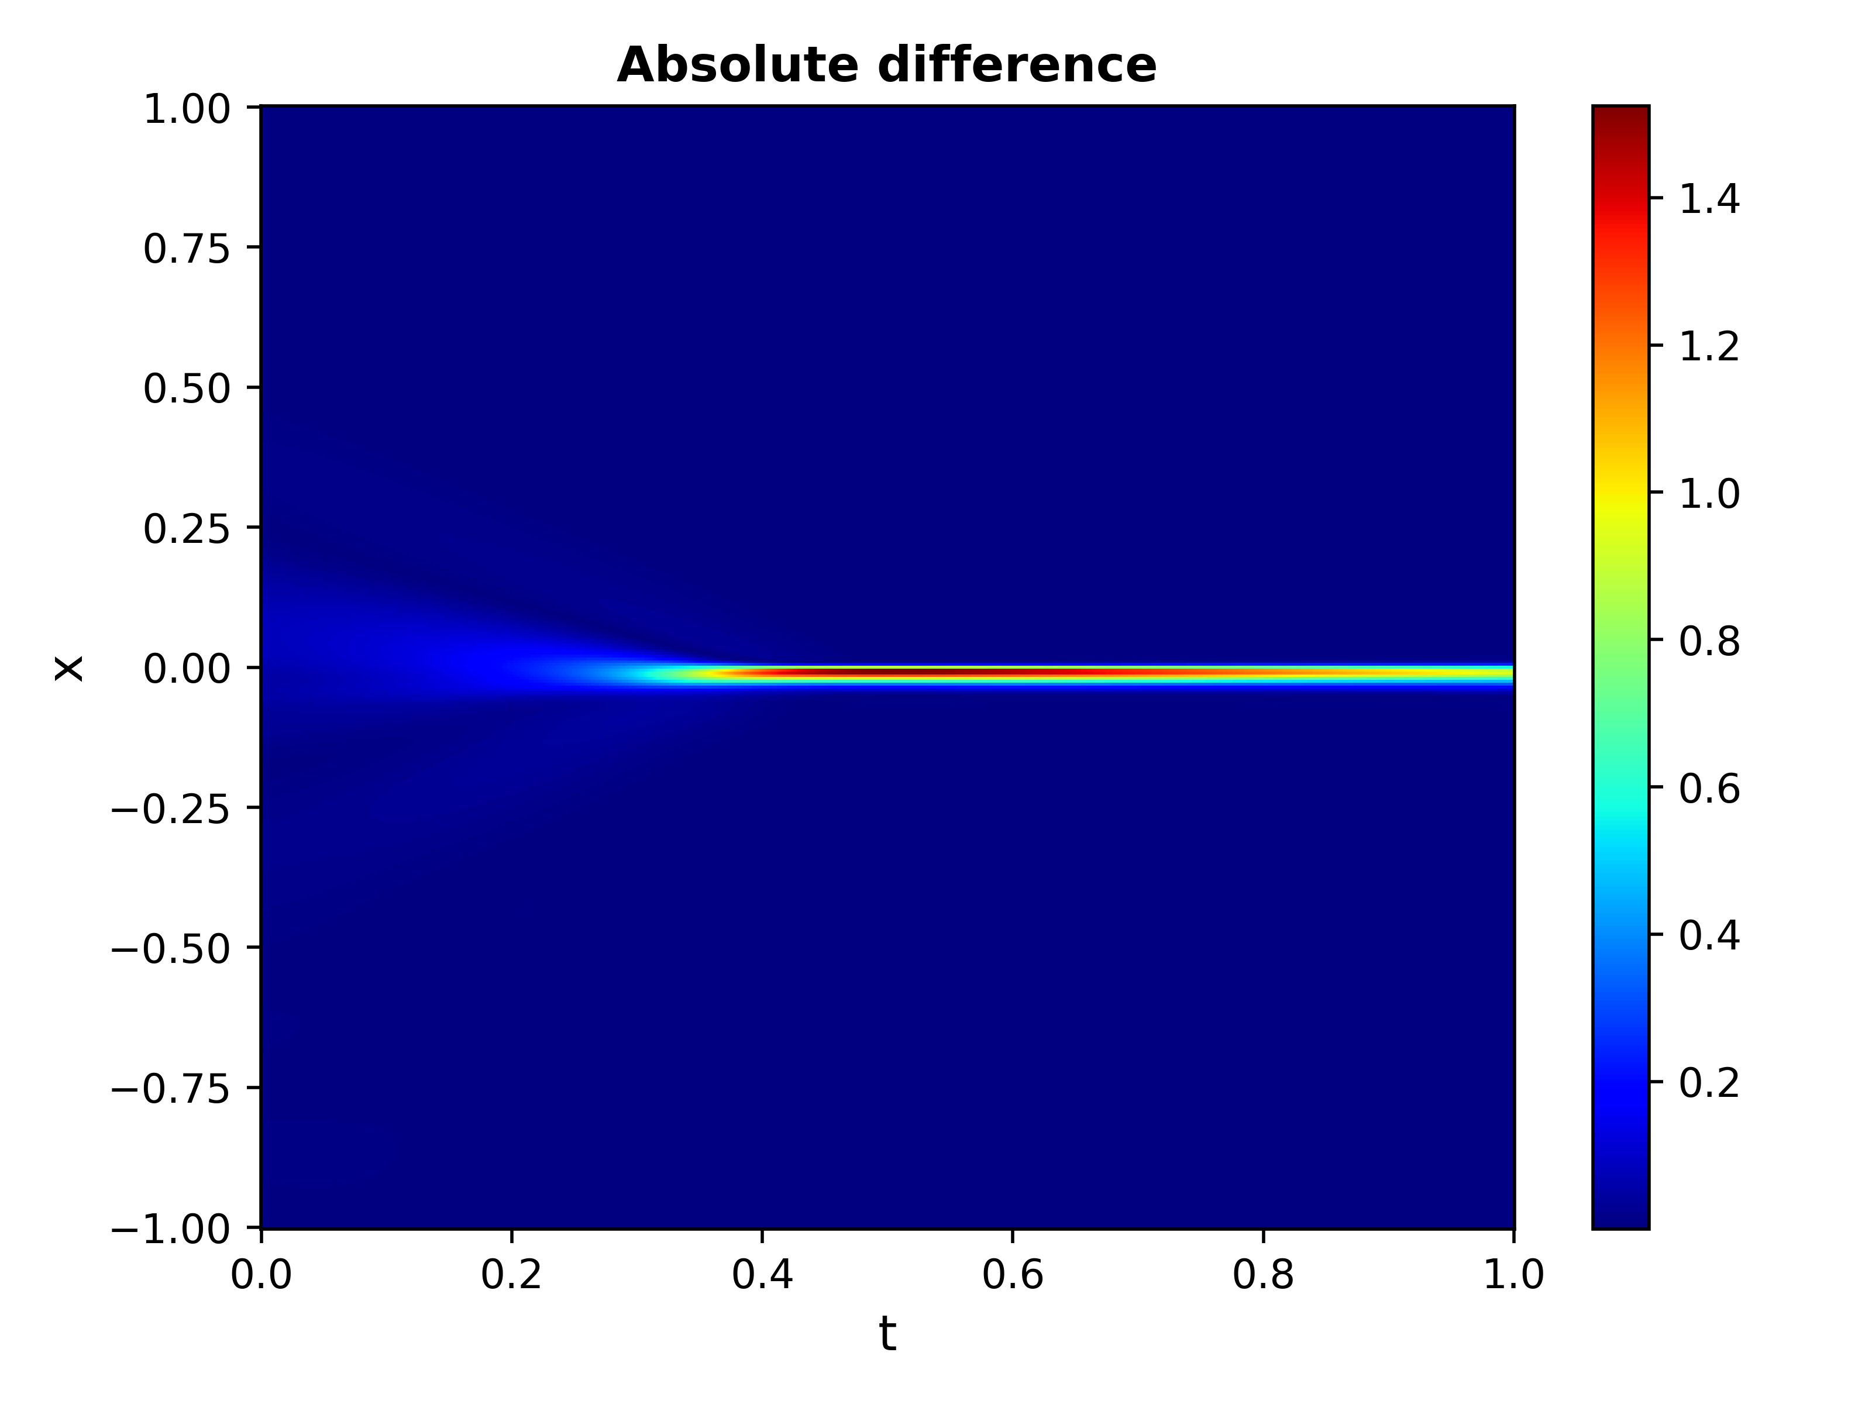
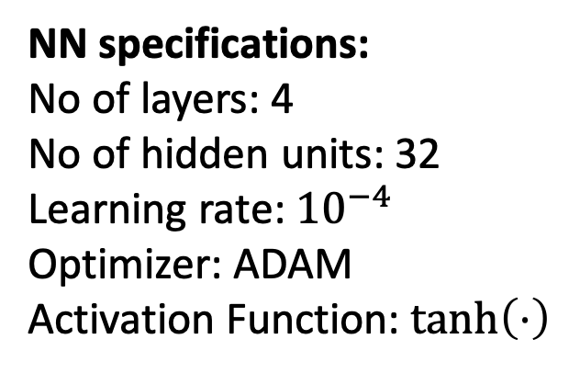
Example
NN specifications:
No of layers: 4
No of hidden units: 32
Learning rate: ${10}^{−4}$
Optimizer: ADAM
Activation Function: $\tanh\left(⋅\right)$

Slide 8
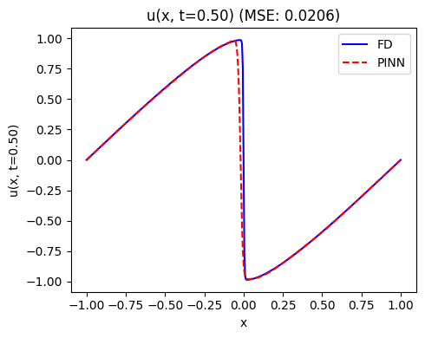
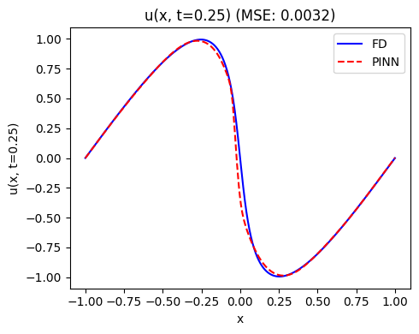
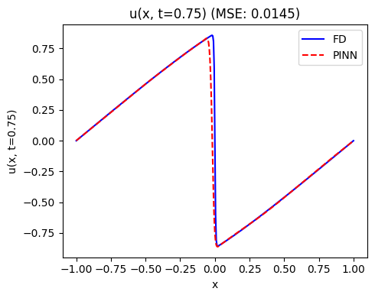
Example
NN specifications:
No of layers: 4
No of hidden units: 32
Learning rate: ${10}^{−4}$
Optimizer: ADAM
Activation Function: $\tanh\left(⋅\right)$

Slide 9
Physics-informed DeepOnet
Unlike PINNs, where we approximate the mapping between finite spaces, PI-DeepOnet approximates a mapping between two infinite spaces. In other words, PI-DeepOnet approximates an operator.[4]
This is based on the theorem of the universal operator approximator (chen & chen, 1995), which states that NNs are capable of approximating a nonlinear functionals using an arbitrary activation function.[5]
This implies that NNs can approximate the solution of parametric PDEs, where a NN learns a family of solutions.

Slide 10
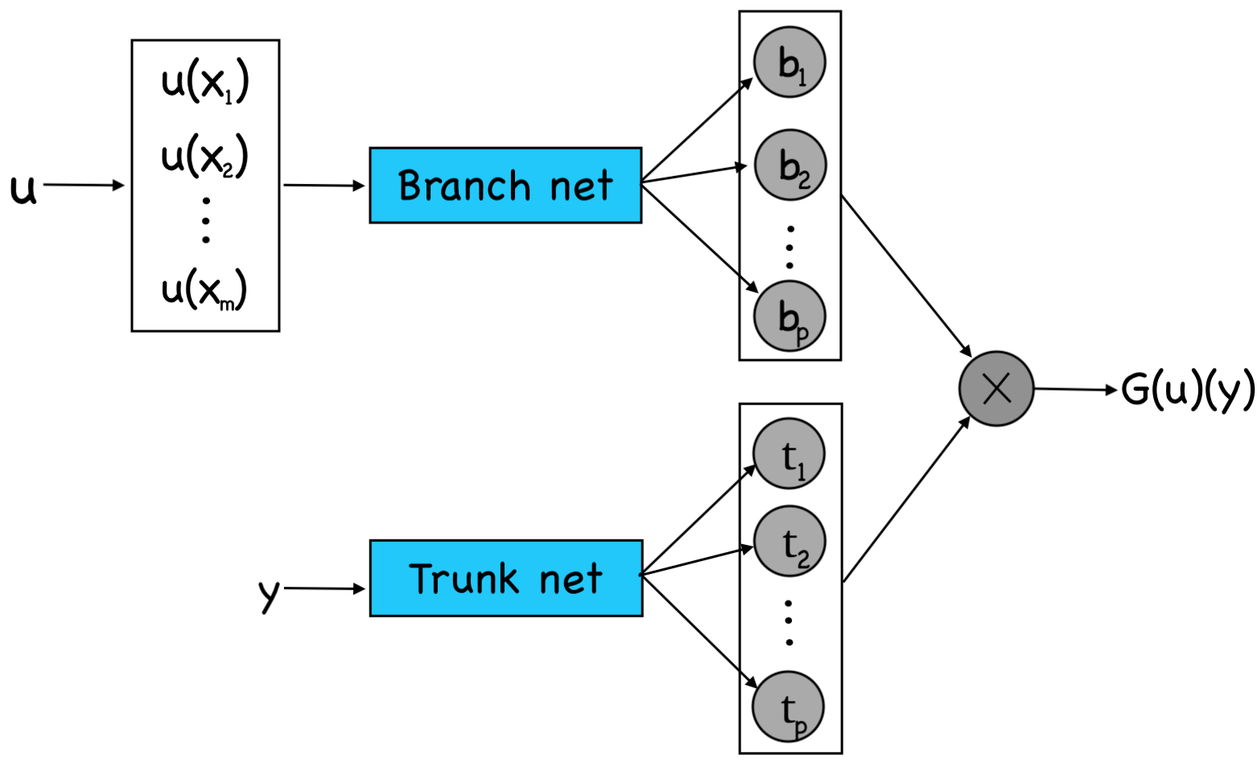
Physics-informed DeepOnet
PI-DeepOnet utilizes two NNs: Branch net and Trunk net.
Branch net takes functions as an input and outputs a function.
Trunk net takes points from the domain as input and maps it to a higher dimension.
The dot product between the two nets is the output function evaluated at specific point.

Slide 11
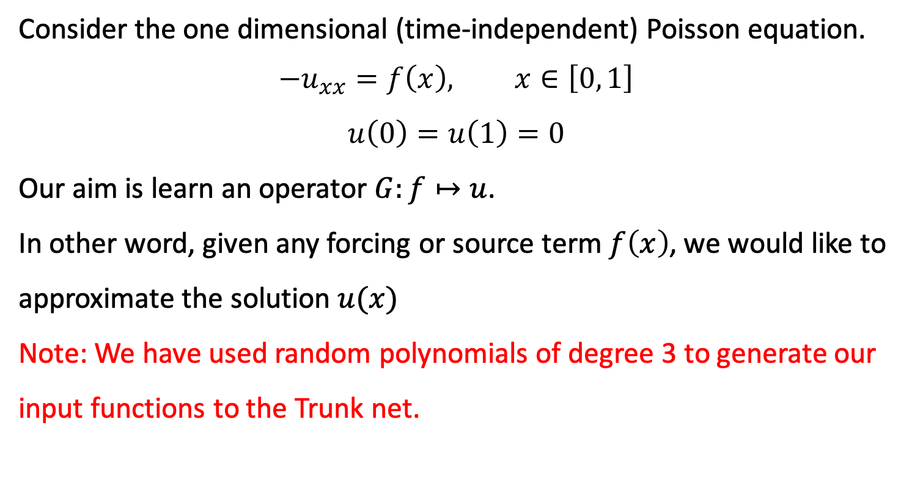
Physics-informed DeepOnet (exmaple)
Consider the one dimensional (time-independent) Poisson equation.
$$−u_{xx}=f\left(x\right), x∈\left[0, 1\right]$$
$$u\left(0\right)=u\left(1\right)=0$$
Our aim is learn an operator $G:f↦u$.
In other word, given any forcing or source term $f\left(x\right)$, we would like to approximate the solution $u(x)$
Note: We have used random polynomials of degree 3 to generate our input functions to the Trunk net.

Slide 12
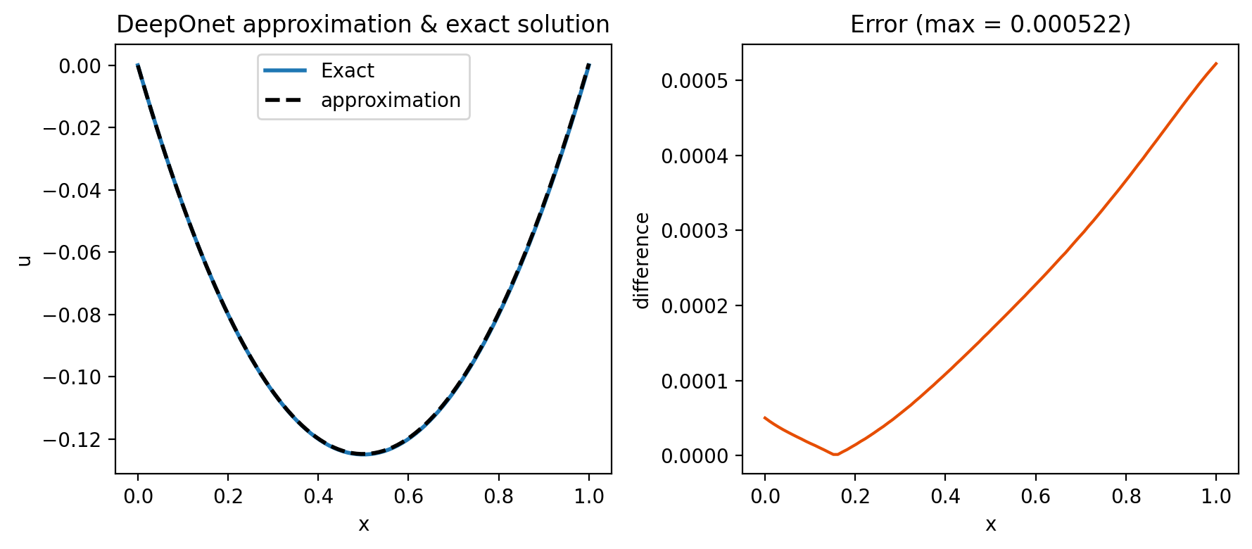
Physics-informed DeepOnet (exmaple)
For $f\left(x\right)=−1$ the exact solution is $u\left(x\right)=\frac{1}{2}(x^{2}−x)$

Slide 13
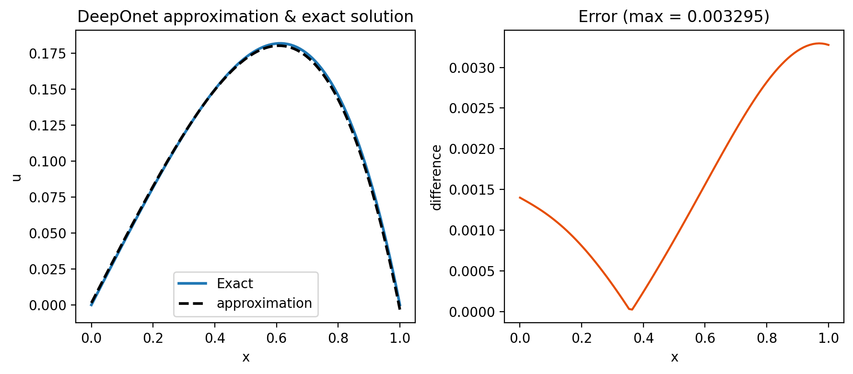
Physics-informed DeepOnet (exmaple)
For $f\left(x\right)=x+3x^{2}$ the exact solution is $u\left(x\right)=−\frac{1}{6}x^{3}−\frac{1}{4}x^{4}+\frac{10}{24}x$

Slide 14
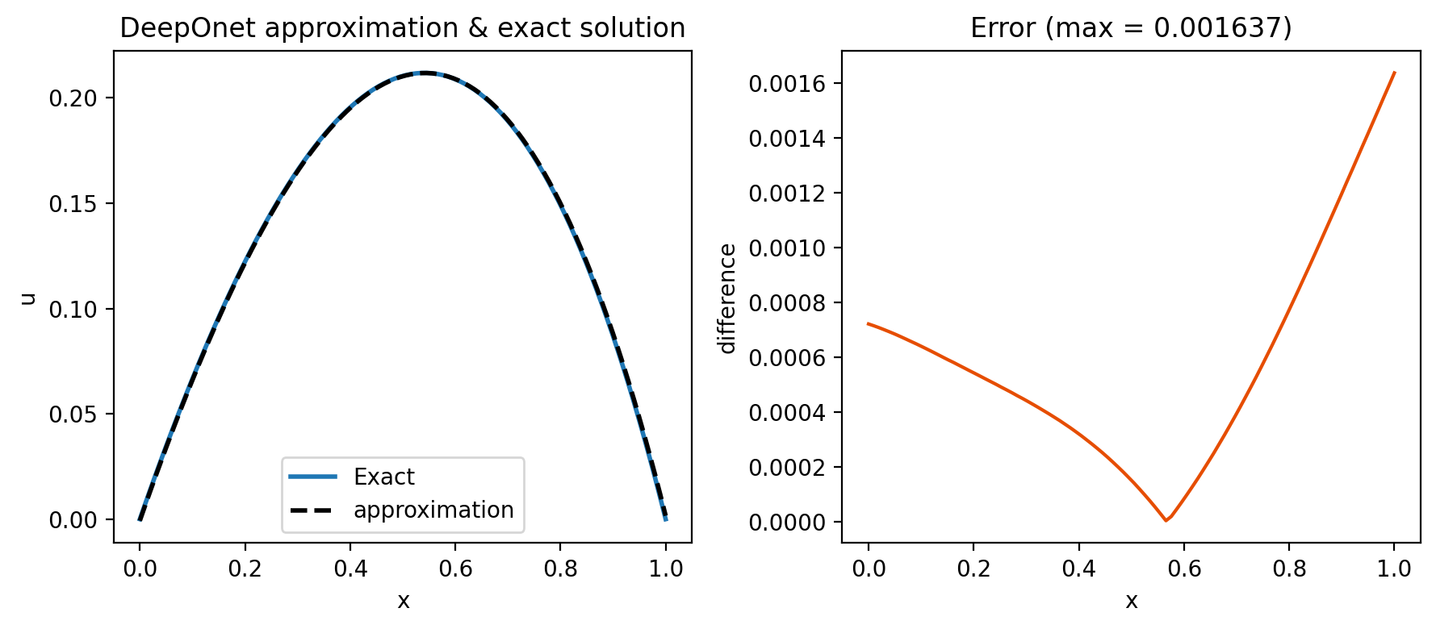
Physics-informed DeepOnet (exmaple)
For $f\left(x\right)=e^{x}$ the exact solution is $u\left(x\right)=−e^{x}+xe−x+1$

Slide 15
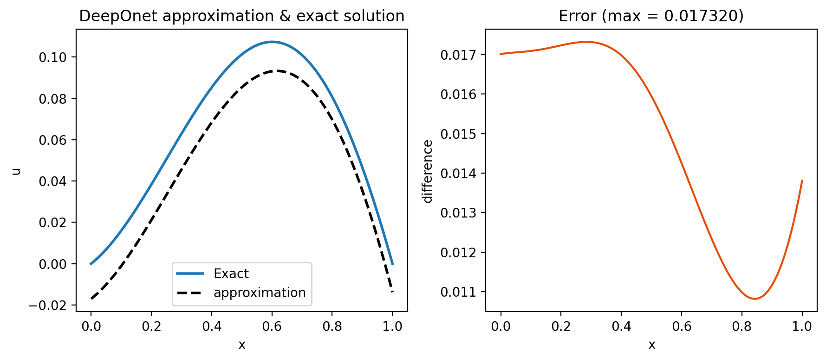
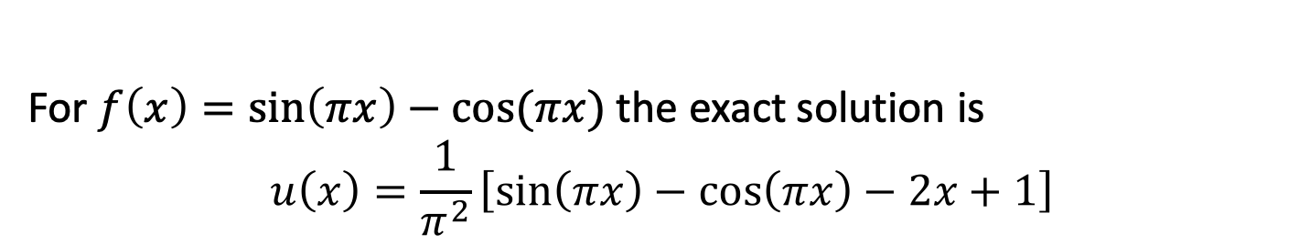
Physics-informed DeepOnet (exmaple)
For $f\left(x\right)=\sin\left(πx\right)−cos⁡(πx)$ the exact solution is
$$u\left(x\right)=\frac{1}{π^{2}}\left[\sin\left(πx\right)−\cos\left(πx\right)−2x+1\right]$$

Slide 16
Applications
Theses physics informed models can be employed in various areas such as
Hemodynamics to study the cardiovascular flows, particularly they can be used to predict the blood’s velocity, its pressure, and wall displacement pulsewave propagation.[6]
geosciences to study earthquakes and to determine the location of the hypocenter where this problem requires solving Eikonal equation.
Applications in electrical engineering can involve solving the transmission line equations or the swing equation.

Slide 17
Conclusion
PINN and DeepOnets demonstrated their ability to approximate the solution of differential equations.
The advantage of using deep learning methods is that they mesh-free, which means they can be used for large domains and high dimensional problems.
The limitations include the accuracy of the approximated solutions, the need for large amount of training data, and the training duration.

Slide 18
References
[1] Hornik, K., Stinchcombe, M., & White, H. (1989). Multilayer feedforward networks are universal approximators. Neural Networks, 2(5), 359–366. https://doi.org/10.1016/0893-6080(89)90020-8.
[2] Hornik, K., Stinchcombe, M., & White, H. (1989). Multilayer feedforward networks are universal approximators. Neural Networks, 2(5), 359–366. https://doi.org/10.1016/0893-6080(89)90020-8.
[3] Bartholomew-Biggs, M., Brown, S., Christianson, B., & Dixon, L. (2000). Automatic differentiation of algorithms. Journal of Computational and Applied Mathematics, 124(1–2), 171–190. https://doi.org/10.1016/s0377-0427(00)00422-2
[4] Wang, S., Wang, H., & Perdikaris, P. (2021). Learning the solution operator of parametric partial differential equations with physics-informed deeponets. Science Advances, 7(40). https://doi.org/10.1126/sciadv.abi8605
[5] Tianping Chen, & Hong Chen. (1995). Universal approximation to nonlinear operators by neural networks with arbitrary activation functions and its application to dynamical systems. IEEE Transactions on Neural Networks, 6(4), 911–917. https://doi.org/10.1109/72.392253

Slide 19
References
[6] Kissas, G., Yang, Y., Hwuang, E., Witschey, W. R., Detre, J. A., & Perdikaris, P. (2020). Machine learning in Cardiovascular flows modeling: Predicting arterial blood pressure from non-invasive 4D flow MRI data using physics-informed Neural Networks. Computer Methods in Applied Mechanics and Engineering, 358, 112623. https://doi.org/10.1016/j.cma.2019.112623.
[7] Smith, J. D., Ross, Z. E., Azizzadenesheli, K., & Muir, J. B. (2021). Hyposvi: Hypocentre inversion with Stein variational inference and physics informed Neural Networks. Geophysical Journal International, 228(1), 698–710. https://doi.org/10.1093/gji/ggab309.
[8] Misyris, G.S., Venzke, A., Chatzivasileiadis, S.: Physics-informed neural networks for power systems.2020 IEEE Power & Energy Society General Meeting (PESGM) pp. 1–5 (2020)
[9] Stiasny J, Misyris GS, Chatzivasileiadis S (2021) Physics-Informed Neural Networks for Non-linearSystem Identification for Power System Dynamics. In: 2021 IEEE Madrid PowerTech, pp 1–6, https://doi.org/10.1109/PowerTech46648.2021.9495063.

